Slide 1
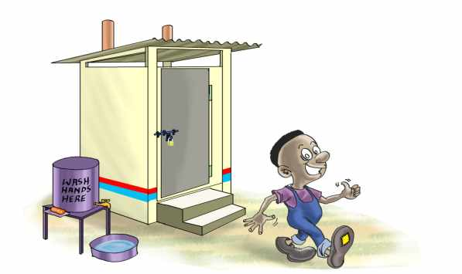
UBSUP Technical Options
Social Animators Training

Slide 2
Sanitation Value Chain
Sanitation should be understood as a system
It’s not only about the toilet!
Storage Collection Transport Treatment Transport Reuse

Slide 3
Technical options available
Options for toilets
Dry Toilets
Double Vault Urine Diversion Toilets (UDDTs).
Cost range: 35,000-85,000
2. Water Based Toilets
Pour flush toilets
Cistern Flush toilets.
Cost range: 35,000-65,000 – Without the septic tanks
The cost will vary in different areas

Slide 4
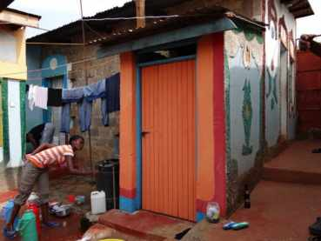
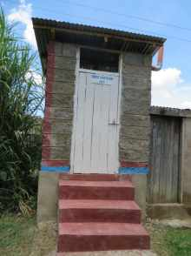
SafiSan Toilets

Slide 5
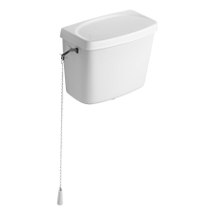
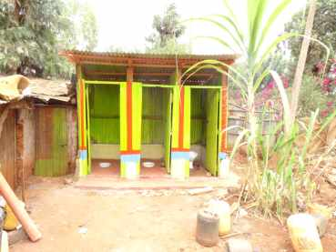
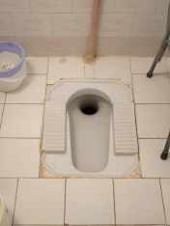
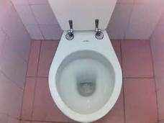
Water Based Toilet Systems
Cistern
WC/Sit Toilet
Squat Toilet

Slide 6
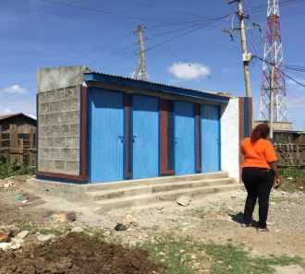
Water Based Toilet Systems ( cont’d)
Materials
Superstructure: earth bricks, quarry stones, concrete blocks
Roofing: Iron sheets.

Slide 7
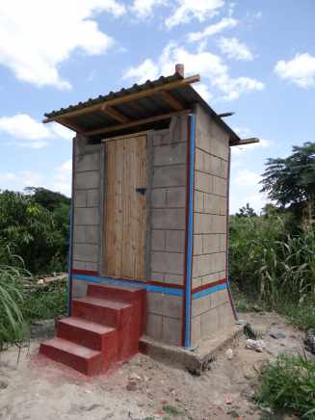
UDDTs
1. Materials ( super structure)
Earth bricks, quarry stones, iron-sheets or concrete blocks
2. Materials ( sub structure-vaults)
Earth bricks, quarry stones or concrete blocks
Above ground and underground vaults
3. Other aspects
Soak pits
4. User Interface
Sitting or squatting;
Stairs or Access ramp

Slide 8
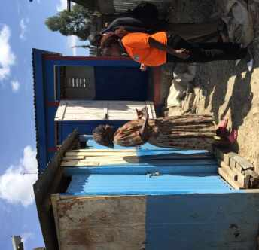
Pros and Cons of Water Based Toilets Based on UBSUP Experiences
Pros
Suitable for all types of users
Accepted by most users in LIAs
Cons
Exhauster costs will be expensive for the landlords
Septic tank construction expensive. Cost not covered in the PCI
Dependent on water availability

Slide 9
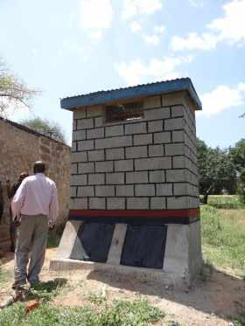
Pros and Cons of UDDTs Based on UBSUP Experiences
Pros
When used well, no odors, no flies,
Collection of UDDT matter by Sanitation team is affordable
Cons
Use and maintenance requires commitment by users
Perception of UDDTs in some areas negative due to past projects that did not cover full value chain
Is prone to clogging with faeces and misuse as seen in a few facilities

Slide 10
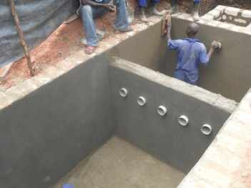
Decentralized Treatment Facilities (DTFs)
The DTF intends to close the Sanitation Value Chain for facilities that are not connected to the sewer by allowing for:
Adequate treatment of Faecal Sludge (FS) / waste water (WW) / UDDT matter
Safe disposal of treated effluent to the environment
Reuse of water for irrigation
Reuse of dried sludge as soil conditioner
Reuse of compost as fertiliser

Slide 11
What is NOT treated in the DTF?
Never to be treated are:
Greywater (from laundry, kitchen, etc.) due to low pollution loads that would negatively affect the treatment performance of the DTF
Storm water as even co-treatment is not beneficial as the treatment capacity of the DTF must then be much higher

Slide 12
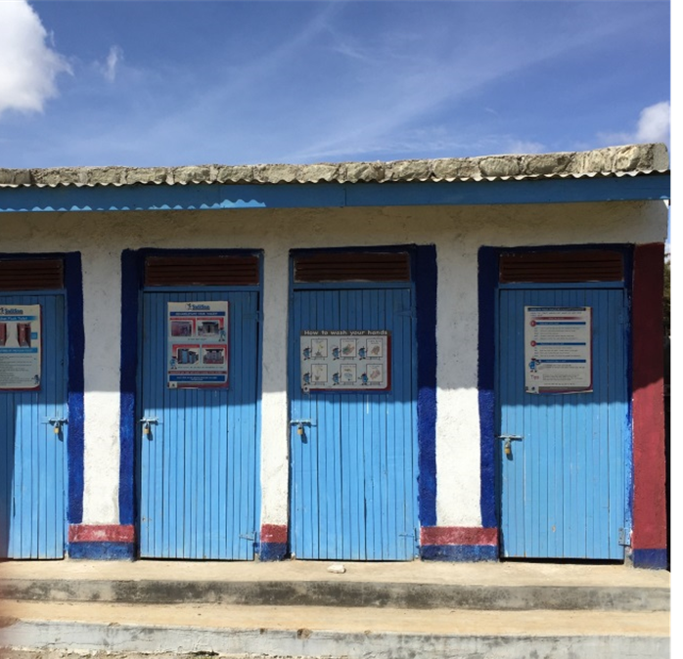
Do you have any questions?

